Slide 1
Biological Modeling of Neural Networks:
Week 14 – Dynamics and Plasticity
14.1 Reservoir computing
- Complex brain dynamics
- Computing with rich dynamics
14.2 Random Networks
- stationary state
- chaos
14.3 Stability optimized circuits
- application to motor data
14.4. Synaptic plasticity
- Hebbian
- Reward-modulated
14.5. Helping Humans
- oscillations
- deep brain stimulation
Week 14 – Dynamics and Plasticity
Wulfram Gerstner
EPFL, Lausanne, Switzerland
Notes:
I ADDED A QUIZ IN THE 2nd lecture.
First lecture: 14.1 and 14.2, reservoir computing and the two different regimes (rate chaos or not). Exercise was integrated from 9:37-9:43h; afterward 2-dim system on blackboard.
Second lecture: Hennequin NEURON paper and three-factor rule. Afterward: course evaluation.
Third lecture: I did not do this in 2014
Third lecture:

Slide 2
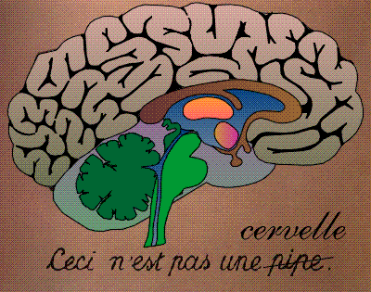
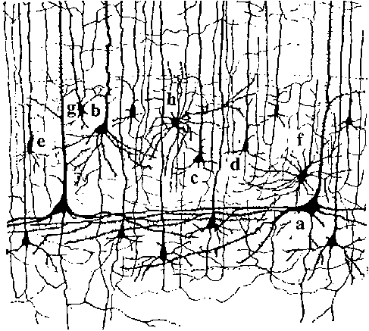
Neuronal Dynamics – Brain dynamics is complex
Week 14-part 1: Review: The brain is complex
10 000 neurons
3 km wire
motor
cortex
1mm
frontal
cortex
to motor
output

Slide 3
Neuronal Dynamics – Brain dynamics is complex
Week 14-part 1: Review: The brain is complex
motor
cortex
Complex internal dynamics
Memory
Response to inputs
Decision making
Non-stationary
Movement planning
More than one ‘activity’ value
frontal
cortex
to motor
output

Slide 4
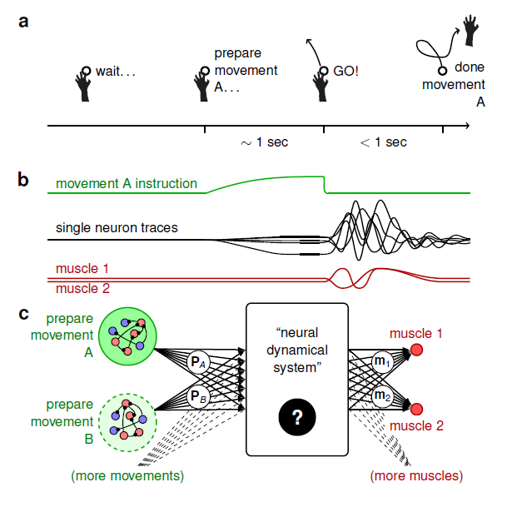
Week 14-part 1: Reservoir computing
Liquid Computing/Reservoir Computing:
exploit rich brain dynamics
Maass et al. 2002,
Jaeger and Haas, 2004
Review:
Maass and Buonomano,
Readout 1
Stream of
sensory inputs
Readout 2

Slide 5
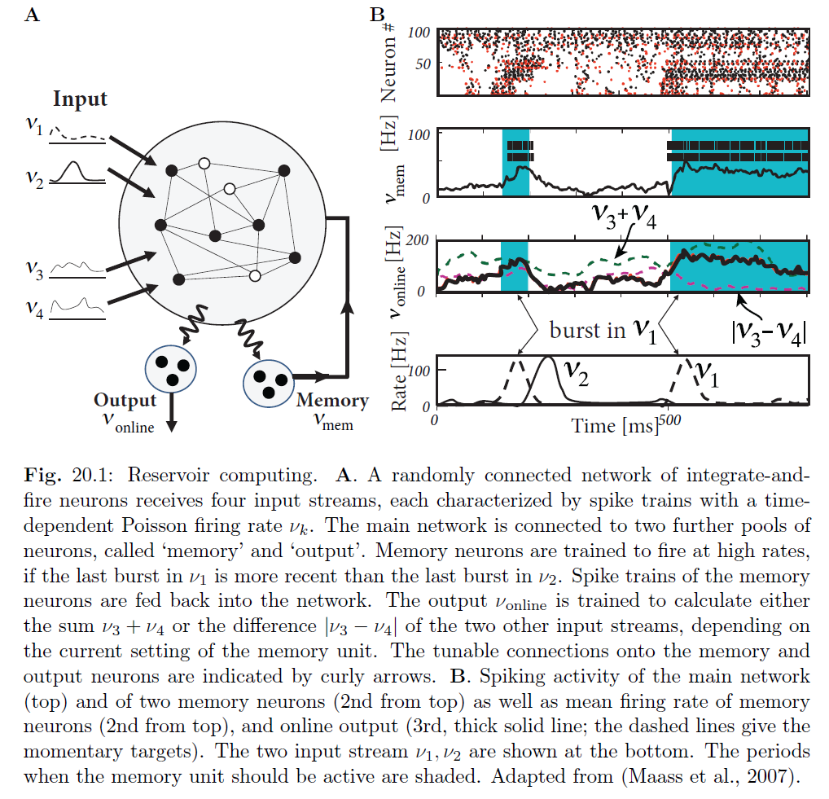
Week 14-part 1: Reservoir computing
See Maass et al. 2007
-‘calculcate’
- if-condition on

Slide 6
Week 14-part 1: Rich dynamics
Rich neuronal dynamics
Experiments of
Churchland et al. 2010
Churchland et al. 2012
See also:
Shenoy et al. 2011
Modeling
Hennequin et al. 2014,
See also:
Maass et al. 2002,
Sussillo and Abbott, 2009
Laje and Buonomano, 2012
Shenoy et al., 2011

Slide 7
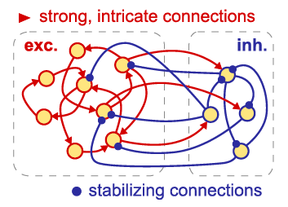
Week 14-part 1: Rich neuronal dynamics: a wish list
Long transients
-Reliable (non-chaotic)
-Rich dynamics (non-trivial)
-Compatible with neural data (excitation/inhibition)
-Plausible plasticity rules

Slide 8
Biological Modeling of Neural Networks:
Week 14 – Dynamics and Plasticity
14.1 Reservoir computing
- Complex brain dynamics
- Computing with rich dynamics
14.2 Random Networks
- rate model
- stationary state and chaos
14.3 Hebbian Plasticity
- excitatory synapses
- inhibitory synapses
14.4. Reward-modulated plasticity
- free solution
14.5. Helping Humans
- oscillations
- deep brain stimulation
Week 14 – Dynamics and Plasticity
Wulfram Gerstner
EPFL, Lausanne, Switzerland
Notes:
2014: Adaptation from a talk on the Guillaume-NEURON paper PLUS final chapter of book.

Slide 9
Week 14-part 2: Review: microscopic vs. macroscopic
I(t)

Slide 10
Week 14-part 2: Review: Random coupling
excitation
Homogeneous network:
each neuron receives input
from k neurons in network
-each neuron receives the same
(mean) external input
inhibition

Slide 11
Week 14-part 2: Review: integrate-and-fire/stochastic spike arrival
Stochastic spike arrival:
excitation, total rate Re
inhibition, total rate Ri
Synaptic current pulses
EPSC
IPSC
Firing times:
Threshold crossing
u
Langevin equation,
Ornstein Uhlenbeck process
→ Fokker-Planck equation

Slide 12
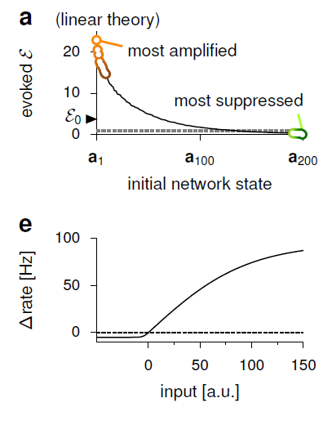
Week 14-part 2: Dynamics in Rate Networks
F-I curve
of rate neuron
Fixed point with F(0)=0 →
Slope 1
Suppose:
stable
unstable
Suppose 1 dimension

Slide 13
Exercise 1: Stability of fixed point
Next lecture:
9h43
Fixed point with F(0)=0 →
Suppose:
Suppose 1 dimension
Calculate stability,
take w as parameter

Slide 14
Week 14-part 2: Dynamics in Rate Networks
Blackboard:
Two dimensions!
Fixed point with F(0)=0 →
Suppose:
Suppose 1 dimension
stable
unstable
w<1
w>1

Slide 15
Week 14-part 2: Dynamics in RANDOM Rate Networks
Random,
10 percent connectivity
Fixed point:
Chaotic dynamics:
Sompolinksy et al. 1988
(and many others:
Amari, ...
stable
unstable

Slide 16
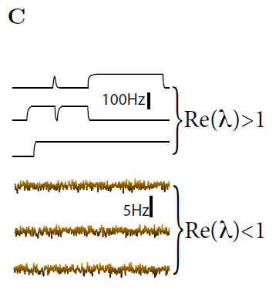
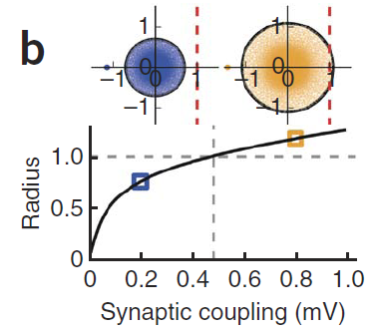
Unstable dynamics and Chaos
chaos
Rajan and Abbott, 2006
Image: Ostojic, Nat.Neurosci, 2014
Image:
Hennequin et al. Neuron, 2014

Slide 17
Week 14-part 2: Dynamics in Random SPIKING Networks
Firing times:
Threshold crossing
Image: Ostojic, Nat.Neurosci, 2014

Slide 18
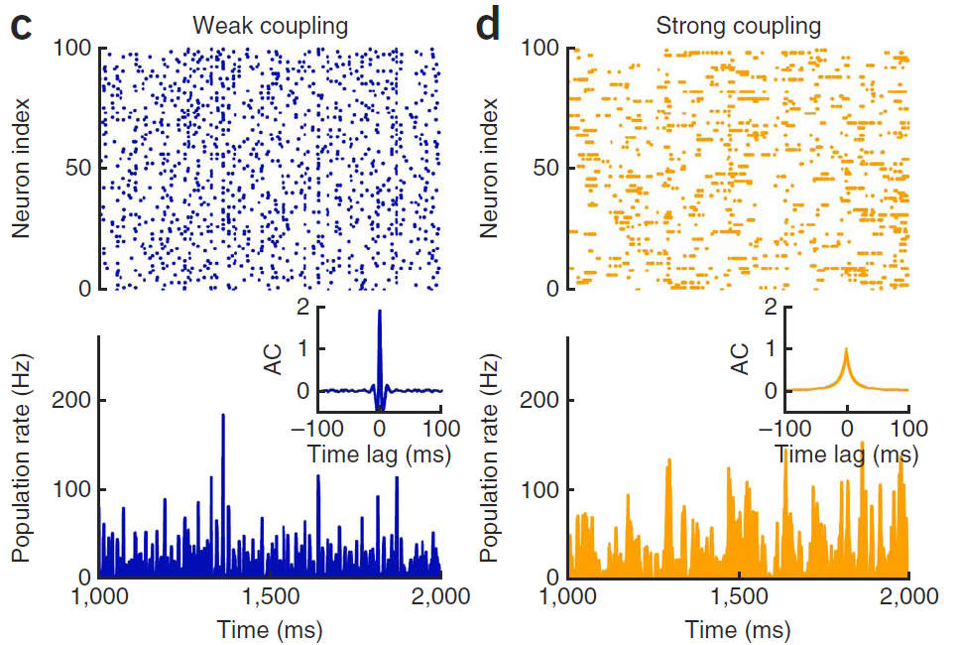
Week 14-part 2: Stationary activity: two different regimes
Switching/bursts →
long autocorrelations:
Rate chaos
Stable rate fixed point,
microscopic chaos
Ostojic,
Nat.Neurosci, 2014

Slide 19
Week 14-part 2: Rich neuronal dynamics: a wish list
Long transients
-Reliable (non-chaotic)
-Rich dynamics (non-trivial)
-Compatible with neural data (excitation/inhibition)
-Plausible plasticity rules

Slide 20
Biological Modeling of Neural Networks:
Week 14 – Dynamics and Plasticity
14.1 Reservoir computing
- Complex brain dynamics
- Computing with rich dynamics
14.2 Random Networks
- stationary state
- chaos
14.3 Stability optimized circuits
- application to motor data
14.4. Synaptic plasticity
- Hebbian
- Reward-modulated
14.5. Helping Humans
- oscillations
- deep brain stimulation
Week 14 – Dynamics and Plasticity
Wulfram Gerstner
EPFL, Lausanne, Switzerland

Slide 21
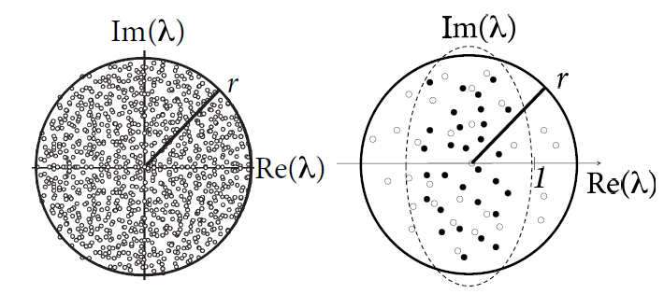
Week 14-part 3: Plasticity-optimized circuit
Image:
Hennequin et al. Neuron, 2014

Slide 22
Optimal control of transient dynamics in balanced networks
supports generation of complex movements
Hennequin et al. 2014,

Slide 23
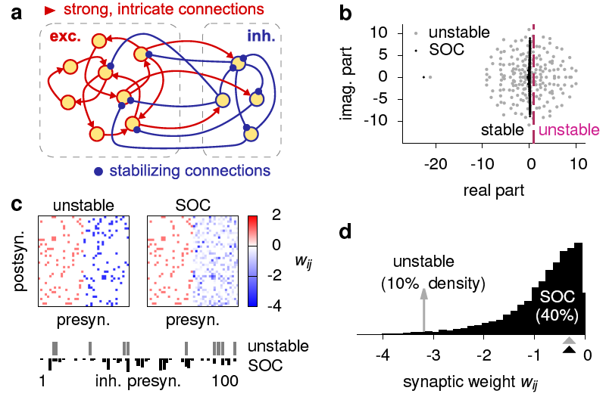
Random stability-optimized circuit (SOC)
Random
connectivity

Slide 24
Week 14-part 3: Random Plasticity-optimized circuit
Random

Slide 25
Week 14-part 3: Random Plasticity-optimized circuit
slope 1/linear theory
study
duration
of transients
slope 1/linear theory
a1= slowest
= most amplified
F-I curve
of rate neuron

Slide 26
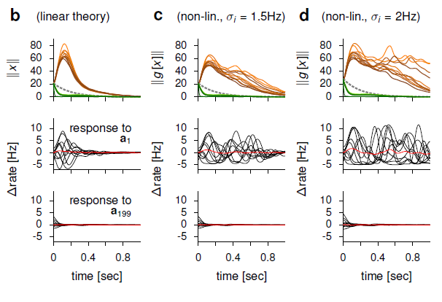
Week 14-part 3: Random Plasticity-optimized circuit
F-I curve
of rate neuron
slope 1/linear theory
a1= slowest
= most amplified

Slide 27
Optimal control of transient dynamics in balanced networks
supports generation of complex movements
Hennequin et al.
NEURON 2014,

Slide 28
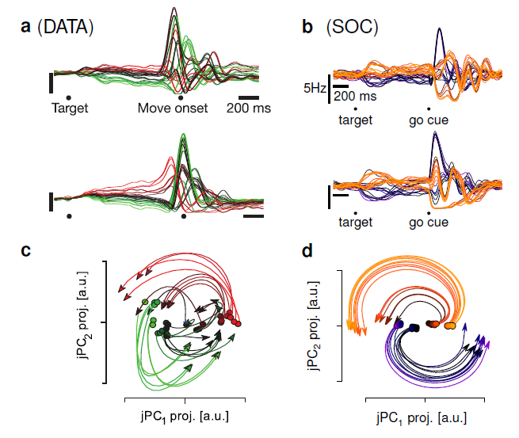
Week 14-part 3: Application to motor cortex: data and model
Churchland et al. 2010/2012
Hennequin et al. 2014

Slide 29
Quiz: experiments of Churchland et al.
Yes
No
No
No
Yes
[ ] Before the monkey moves his arm, neurons in motor-related
areas exhibit activity
[ ] While the monkey moves his arm, different neurons in motor-
related area show the same activity patterns
[ ] while the monkey moves his arm, he receives information
which of the N targets he has to choose
[ ] The temporal spike pattern of a given neuron
is nearly the same, between
one trial and the next (time scale of a few milliseconds)
[ ] The rate activity pattern of a given neuron
is nearly the same, between
one trial and the next (time scale of a hundred milliseconds)

Slide 30
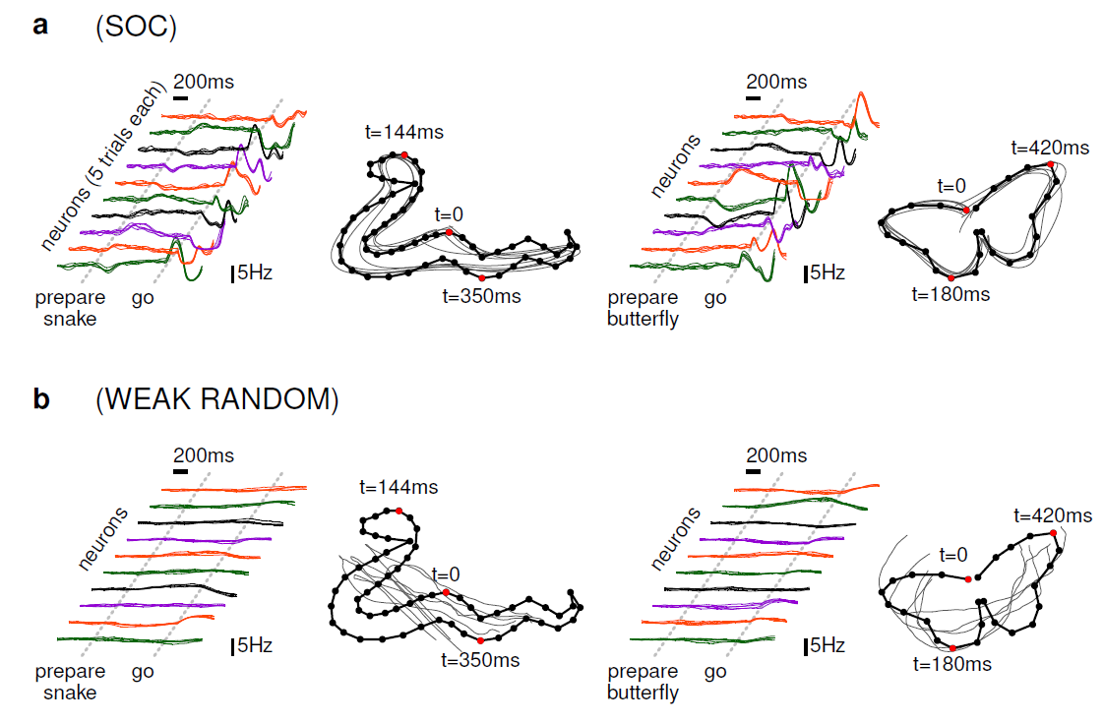
Week 14-part 3: Random Plasticity-optimized circuit
Comparison: weak random
Hennequin et al. 2014,

Slide 31
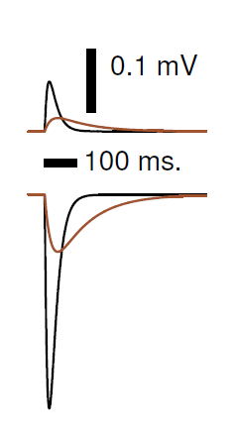
Week 14-part 3: Stability optimized SPIKING network
Classic sparse random connectivity (Brunel 2000)
Random connections, fast
Fast → AMPA
Stabilizy-optimized random connections
slow → NMDA
‘distal’ connections, slow,
(Branco&Hausser, 2011)
structured
Overall:
20% connectivity
12000 excitatory LIF = 200 pools of 60 neurons
3000 inhibitory LIF = 200 pools of 15 neurons

Slide 32
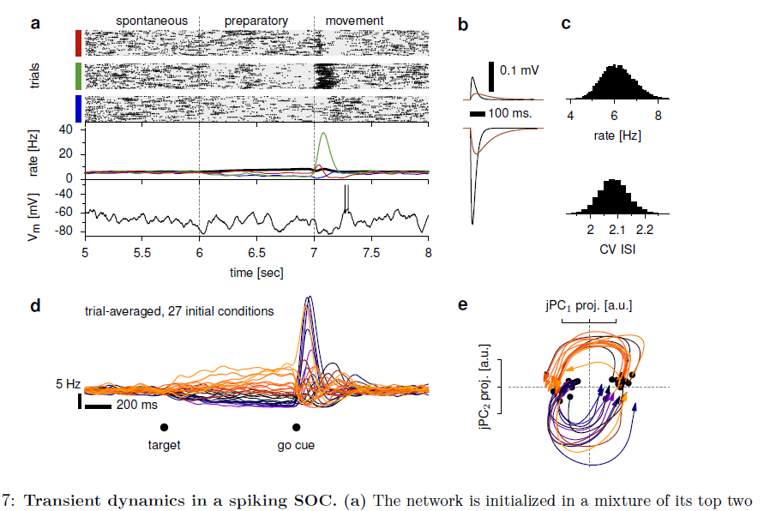
Week 14-part 3: Stability optimized SPIKING network
Spontaneous
firing rate
Classic sparse random connectivity (Brunel 2000)
Neuron 1
Neuron 2
Neuron 3
Single neuron
different initial conditions
Hennequin et al. 2014

Slide 33
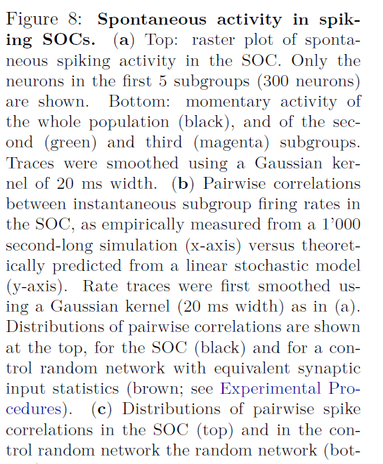
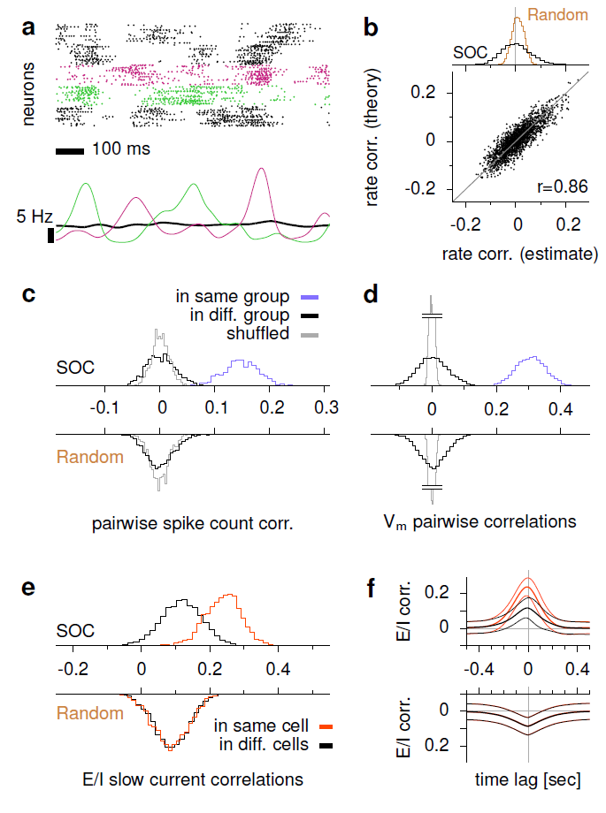
Week 14-part 3: Stability optimized SPIKING network
Classic sparse random connectivity (Brunel 2000)
Hennequin et al. 2014

Slide 34
Week 14-part 3: Rich neuronal dynamics: a result list
Long transients
-Reliable (non-chaotic)
-Rich dynamics (non-trivial)
-Compatible with neural data (excitation/inhibition)
-Plausible plasticity rules

Slide 35
Biological Modeling of Neural Networks:
Week 14 – Dynamics and Plasticity
14.1 Reservoir computing
- complex brain dynamics
- Computing with rich dynamics
14.2 Random Networks
- stationary state
- chaos
14.3 Stability optimized circuits
- application to motor data
14.4. Synaptic plasticity
- Hebbian
- Reward-modulated
14.5. Helping Humans
- oscillations
- deep brain stimulation
Week 14 – Dynamics and Plasticity
Wulfram Gerstner
EPFL, Lausanne, Switzerland
Notes:
2014: Adaptation from a talk on the Guillaume-NEURON paper PLUS final chapter of book.

Slide 36
Hebbian Learning
= all inputs/all times are equal
pre
post
i
j

Slide 37
Week 14-part 4: STDP = spike-based Hebbian learning
Pre-before post: potentiation of synapse
Pre-after-post: depression of synapse

Slide 38
Modulation of Learning
= Hebb+ confirmation
confirmation
Functional Postulate
Useful for learning the important stuff
local global
Many models (and experiments) of synaptic plasticity
do not take into account Neuromodulators.
Except: e.g. Schultz et al. 1997, Wickens 2002, Izhikevich, 2007; Reymann+Frey 2007;
Moncada 2007, Pawlak+Kerr 2008; Pawlak et al. 2010

Slide 39
Consolidation of Learning
Confirmation
Novel
Interesting
Rewarding
Surprising
Success/reward
Neuromodulators
dopmaine/serotonin/Ach
‘write now’
to long-term memory’
Crow (1968),
Fregnac et al (2010),
Izhikevich (2007)

Slide 40
Plasticity
Stability-optimized curcuits
- here: algorithmically tuned
BUT
- replace by inhibitory plasticity
Vogels et al.,
Science 2011
→ avoids chaotic blow-up of network
→ avoids blow-up of single neuron (detailed balance)
→ yields stability optimized circuits

Slide 41
Plasticity
Readout
- here: algorithmically tuned
Izhikevich, 2007
Fremaux et al.
2012
BUT
- replace by 3-factor plasticity rules
Success signal

Slide 42
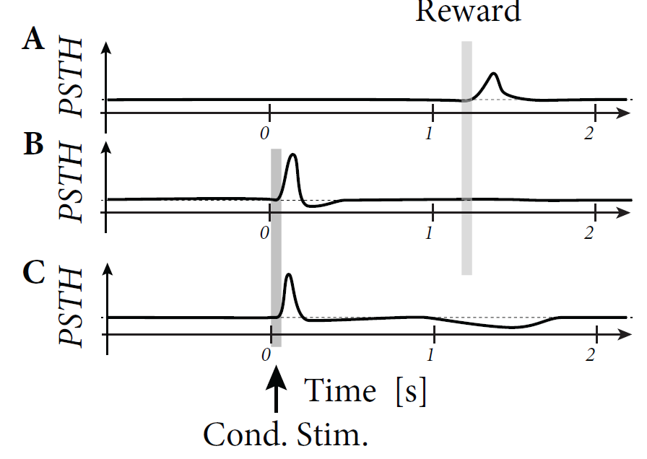
Week 14-part 4: Plasticity modulated by reward
Dopamine-emitting neurons:
Schultz et al., 1997
Izhikevich, 2007
Fremaux et al.
2012
Success signal
Dopamine encodes success=
reward – expected reward

Slide 43
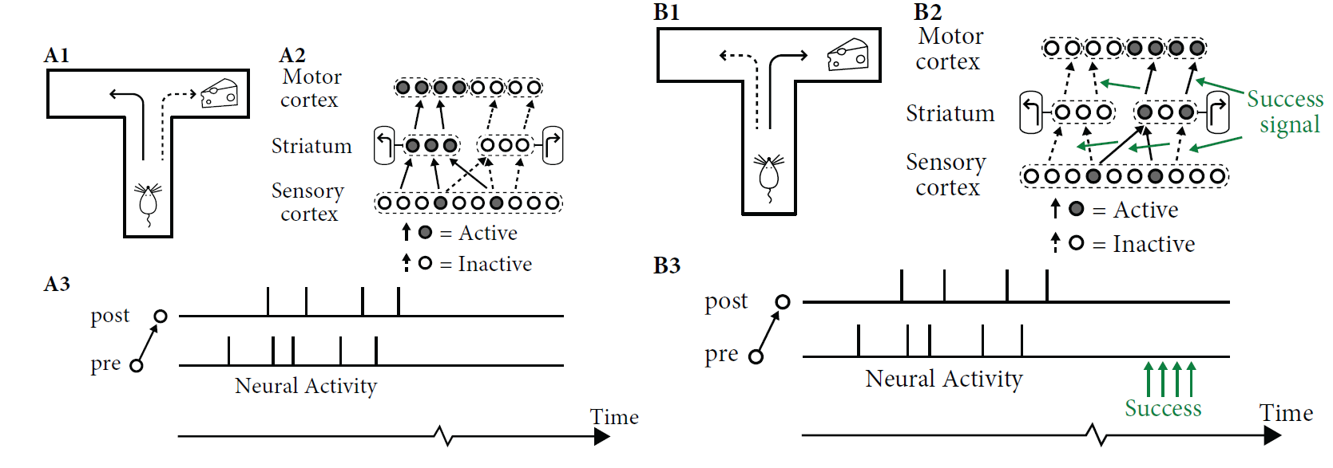
Week 14-part 4: Plasticity modulated by reward

Slide 44
Week 14-part 4: STDP = spike-based Hebbian learning
Pre-before post: potentiation of synapse

Slide 45
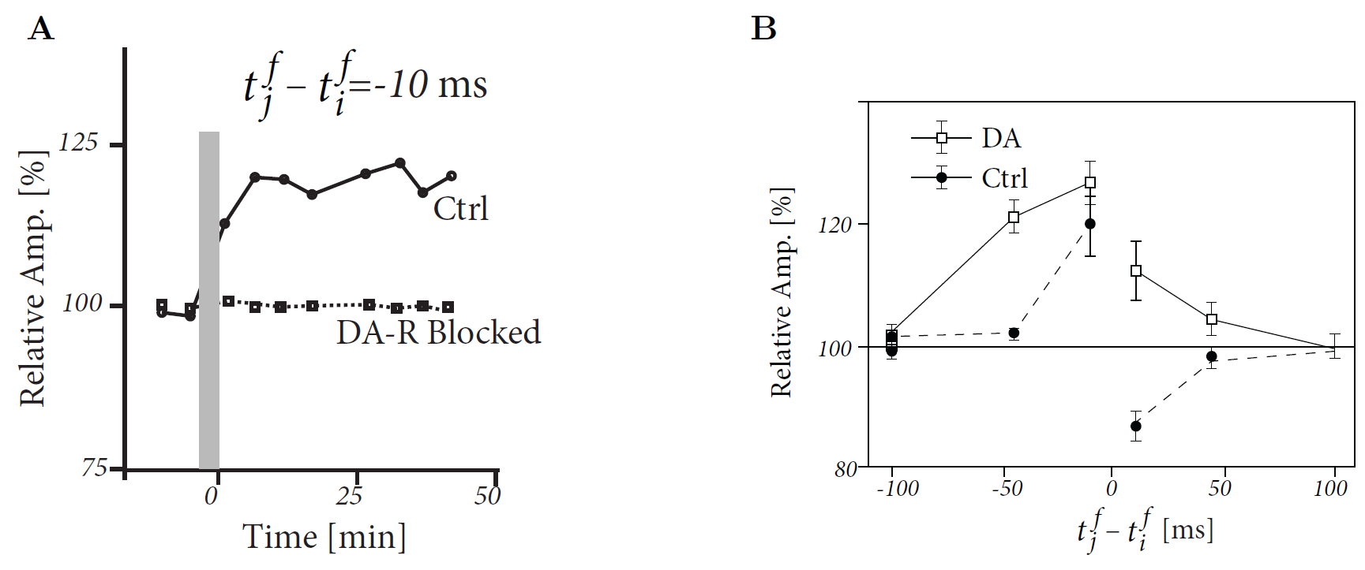
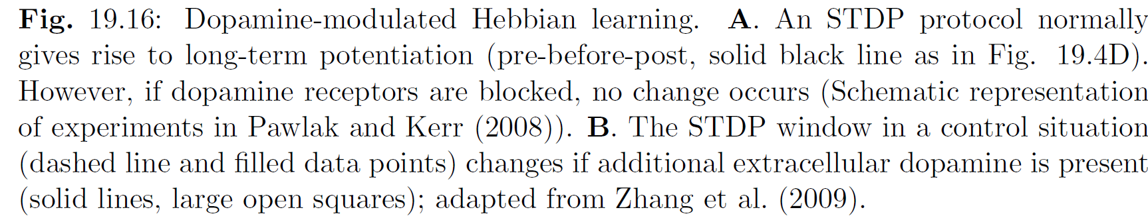
Week 14-part 4: Plasticity modulated by reward
STDP with pre-before post: potentiation of synapse

Slide 46
Quiz: Synpatic plasticity: 2-factor and 3-factor rules
[ ] a Hebbian learning rule depends only on presynaptic
and postsynaptic variables, pre and post
[ ] a Hebbian learning rule can be written abstractly as
[ ] STDP is an example of a Hebbian learning rule
[ ] a 3-factor learning rule can be written as
[ ] a reward-modulated learning rule can be written abstractly as
[ ] a reward-modulated learning rule can be written abstractly as

Slide 47
Week 14-part 4: from spikes to movement
How can the
readouts
encode movement?

Slide 48
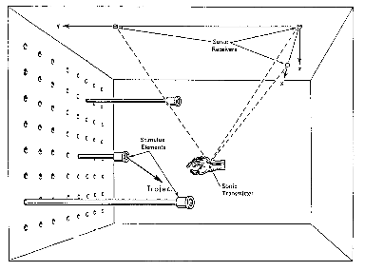
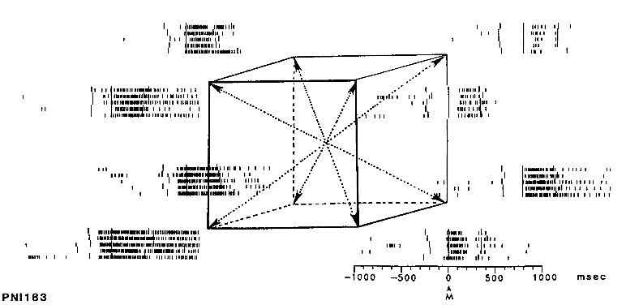
Week 14-part 5: Population vector coding
Population vector coding of movements
Schwartz et al.
1988

Slide 49
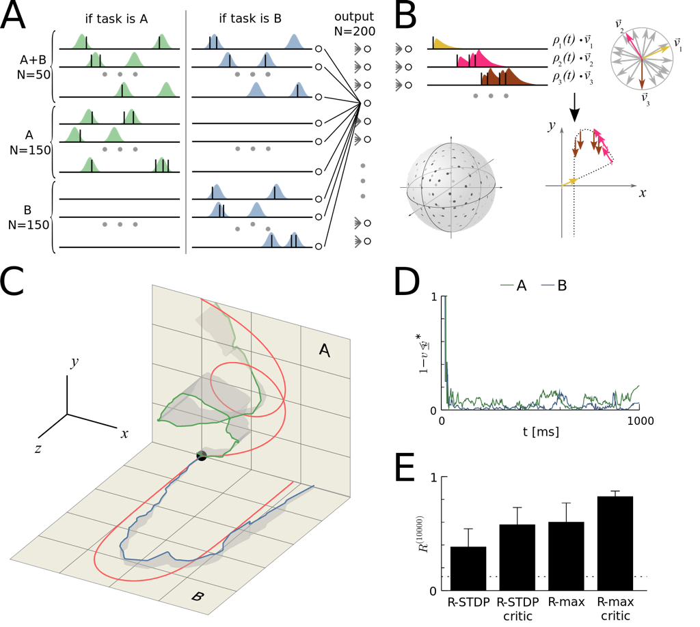
Week 14-part 4: Learning movement trajectories
Population vector coding of movements
70’000 synapses
1 trial =1 second
Output to trajectories via population vector coding
Single reward at the END of each trial based on similarity with a target trajectory
Fremaux et al., J. Neurosci. 2010

Slide 50
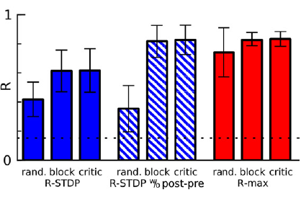
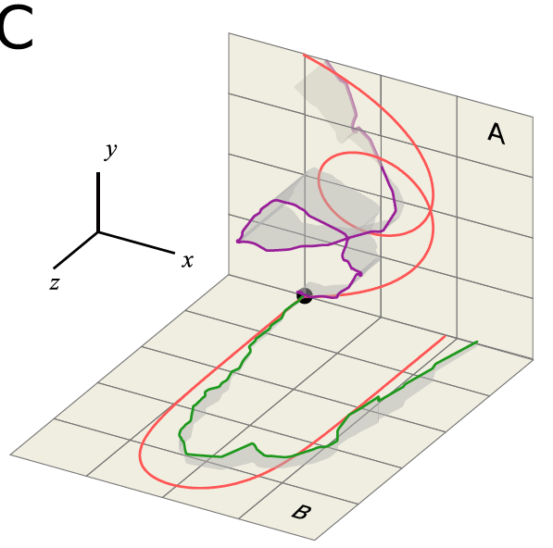
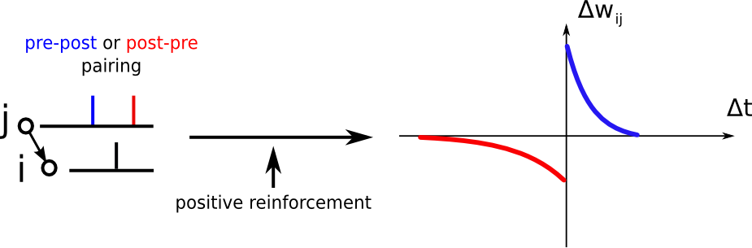
Week 14-part 4: Learning movement trajectories
Fremaux et al. J. Neurosci. 2010
Performance
LTP-only
R-STDP

Slide 51
Week 14-part 4: Plasticity can tune the network and readout
Hebbian STDP
- inhibitory connections, tuned
by 2-factor STDP, for
stabilization
Vogels et al.
2011
Fremaux et al.
2012
Reward-modulated
STDP for movement learning
- Readout connections, tuned
by 3-factor plasticity rule
Success signal

Slide 52
Last Lecture TODAY
Exam:
- written exam 17. 06. 2014 from 16:15-19:00
- miniprojects counts 1/3 towards final grade
For written exam:
-bring 1 page A5 of own notes/summary
-HANDWRITTEN!

Slide 53
Nearly the end:
what can I improve for the students next year?
Integrated exercises?
Quizzes?
Miniproject?
Overall workload ?(4 credit course = 6hrs per week)
Background/Prerequisites?
-Physics students
-SV students
-Math students
Slides?
videos?

Slide 54
Biological Modeling of Neural Networks:
Week 14 – Dynamics and Plasticity
14.1 Reservoir computing
- Review:Random Networks
- Computing with rich dynamics
14.2 Random Networks
- stationary state
- chaos
14.3 Stability optimized circuits
- application to motor data
14.4. Synaptic plasticity
- Hebbian
- Reward-modulated
14.5. Helping Humans
- oscillations
- deep brain stimulation
Week 14 – Dynamics and Plasticity
Wulfram Gerstner
EPFL, Lausanne, Switzerland
Notes:
First lecture: 14.1 and 14.2, reservoir computing and the two different regimes (rate chaos or not). Exercise was integrated from 9:37-9:43h; afterward 2-dim system on blackboard.
Second lecture: Hennequin NEURON paper and three-factor rule. Afterward: course evaluation.
Third lecture: would be part 14.5, but I did not do this in 2014

Slide 55
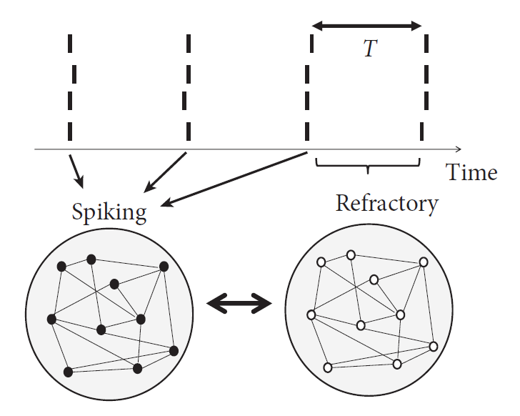
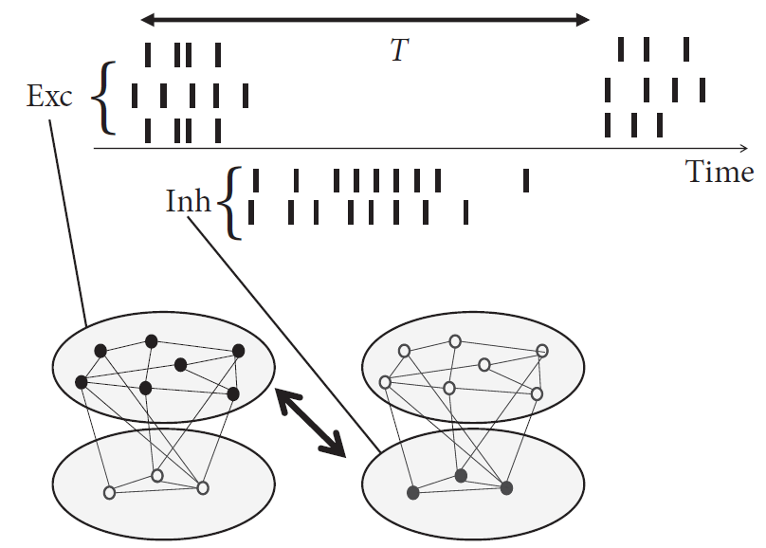
Week 14-part 5: Oscillations in the brain
Individual neurons
fire regularly
two groups alternate

Slide 56
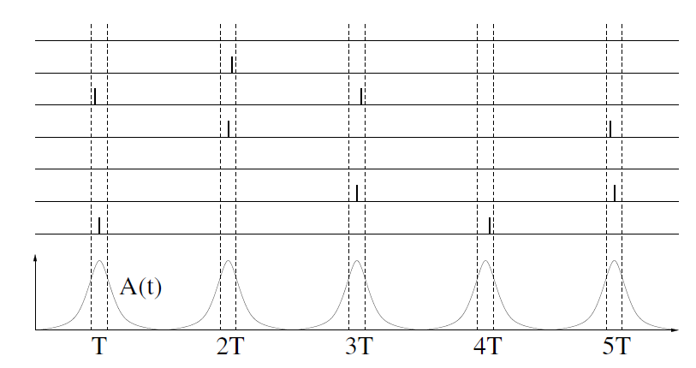
Week 14-part 5: Oscillations in the brain
Individual neurons fire irregularly

Slide 57
Week 14-part 5: STDP

Slide 58
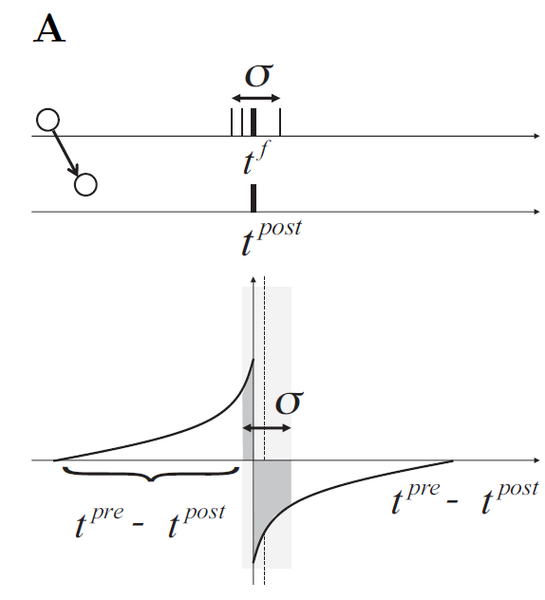
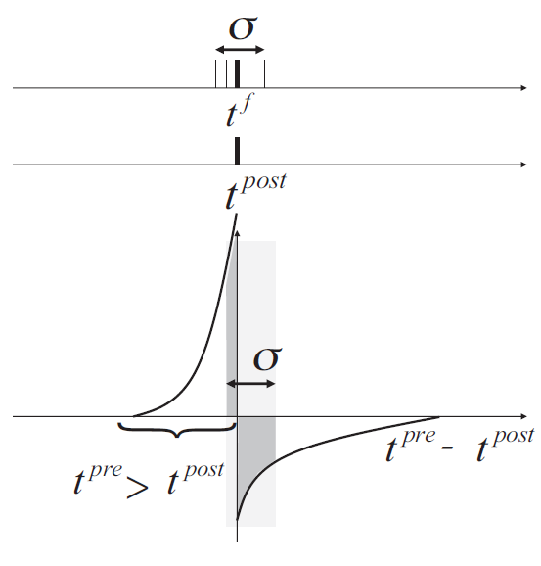
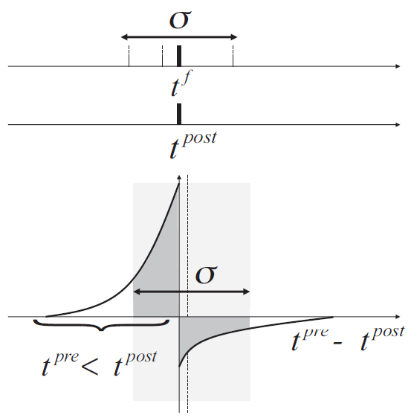
Week 14-part 5: STDP during oscillations
Oscillation→ near-synchronous spike arrival

Slide 59
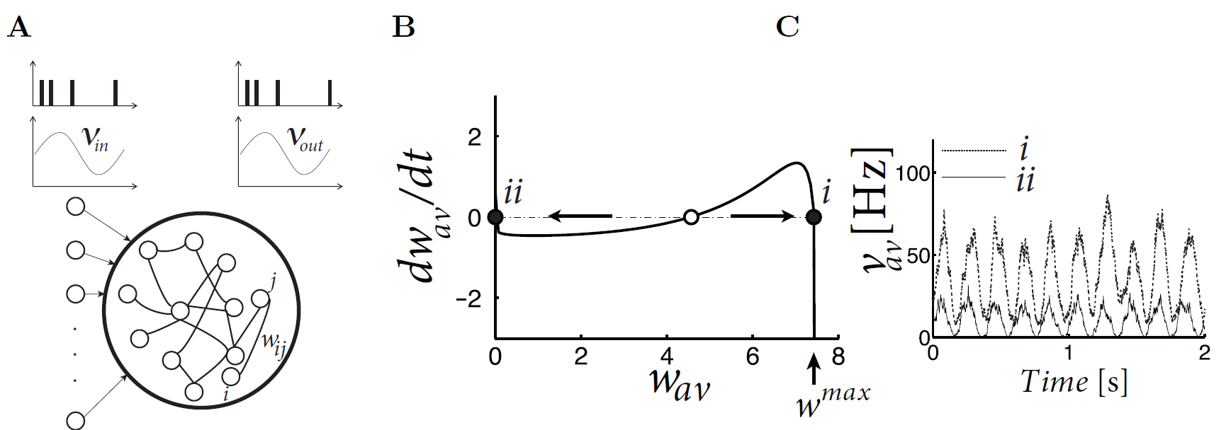
Week 14-part 5: Helping Humans
big weights
Pfister and Tass, 2010
small weights

Slide 60
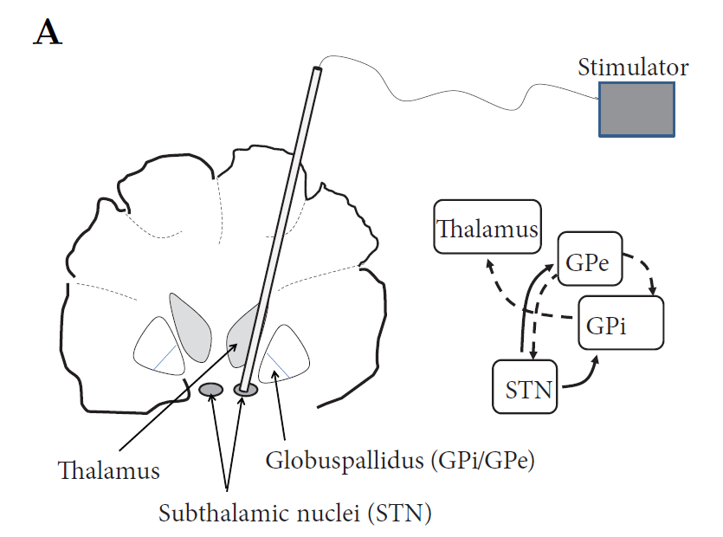
Week 14-part 5: Helping Humans: Deep brain stimulation
Parkinson’s disease:
Symptom: Tremor
-periodic shaking
- 3-6 Hz
Deep brain stimulation
Benabid et al, 1991, 2009
Brain activity:
- thalamus, basal ganglia
- synchronized 3-6Hz in Parkinson
-

Slide 61
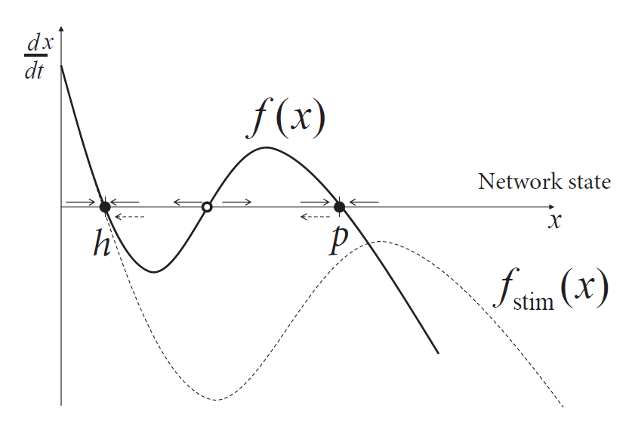
Week 14-part 5: Helping Humans
healthy
pathological
Abstract
Dynamical
Systems
View of
Brain states

Slide 62
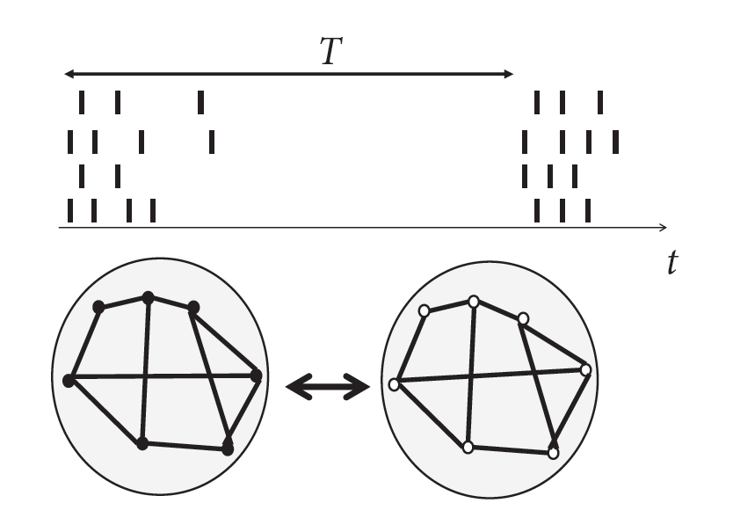
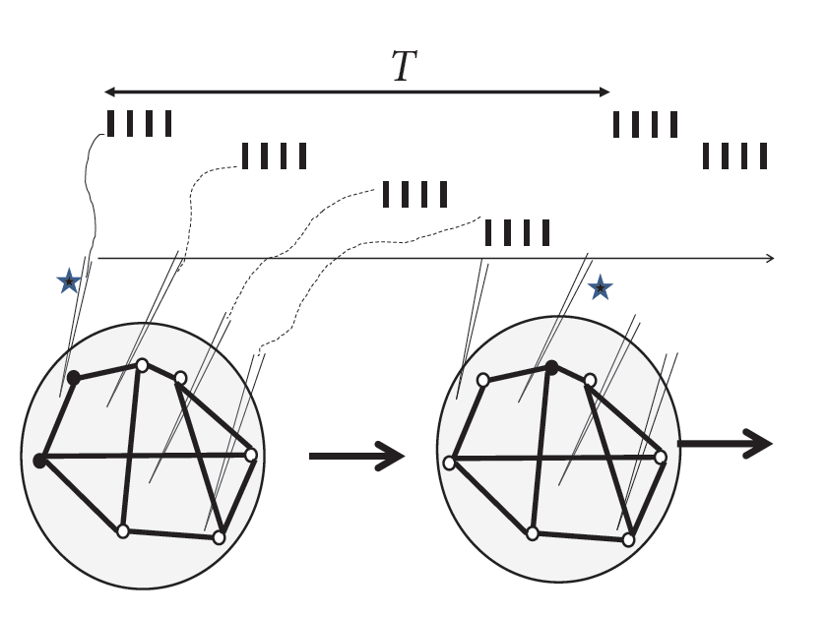
Week 14-part 5: Helping Humans: coordinated reset
Pathological, synchronous
Coordinated reset stimulus

Slide 63
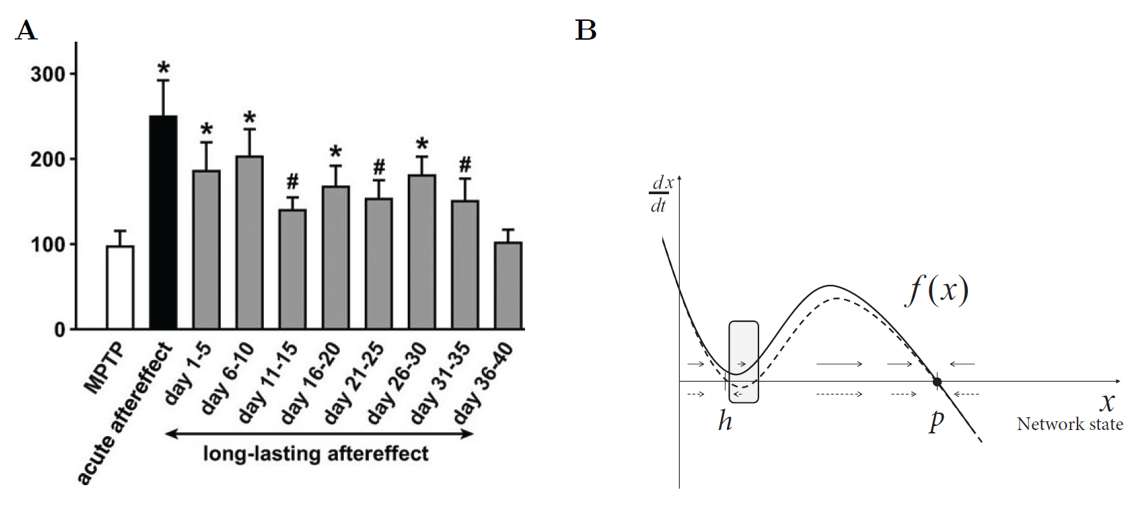
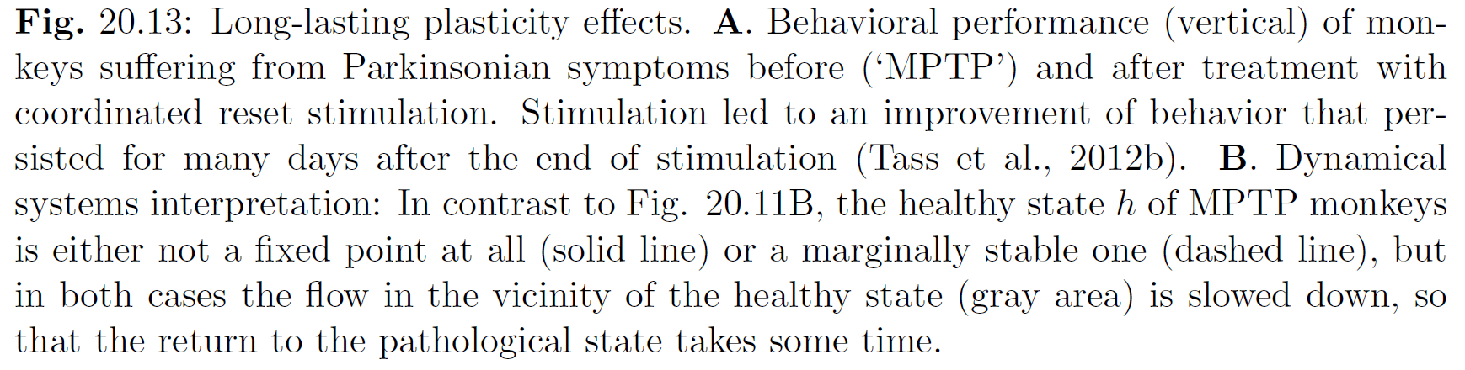
Week 14-part 5: Helping Humans
Tass et al. 2012

Slide 64
Theoretical concepts
→ can help to understand brain dynamics
→ contribute to understanding plasticity and learning
→ inspire medical approaches
→ can help humans
The End
Plasticity and Neuronal Dynamics

Slide 65
now QUESTION SESSION!
Questions to Assistants possible until June 1
The end
… and good luck for the exam!

Slide 66
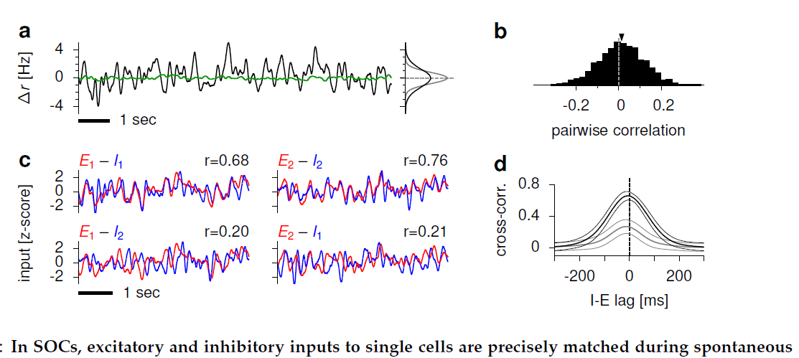
Week 14-part 3: Correlations in Plasticity-optimized circuit
Hennequin et al. 2014,

